Slide 1

FINAL PROJECT
TITLE
Income Classification using k-NN (K Nearest Neighbors) and Naïve Bayes
GROUP - 19
S.NO | NAME | STUDENT ID
1 | Ajith Raj Periyasamy | 811316336
2 | Tejasvin Maddineni | 811314004

Slide 2
OVERVIEW:
Goal - Classifying Target Variable [Income] into <=50k or >50k.
Method – Binary Classification.
Algorithms Used – k-NN [K- Nearest Neighbors] & Naïve Bayes.
Rows – 32561
Columns – 15
Categorical Variables - 8
Numerical Variables - 7

Slide 3
DATA CLEANING:
Missing values in data were identified to be ‘?’
Converted all ‘?’ to ‘NA’ to deal with them easily.
% of ‘NAs’ were 0.87%. Decided to omit them since they were less than 5%. Used ‘na.omit’ to remove the ‘NA’ values.

Slide 4
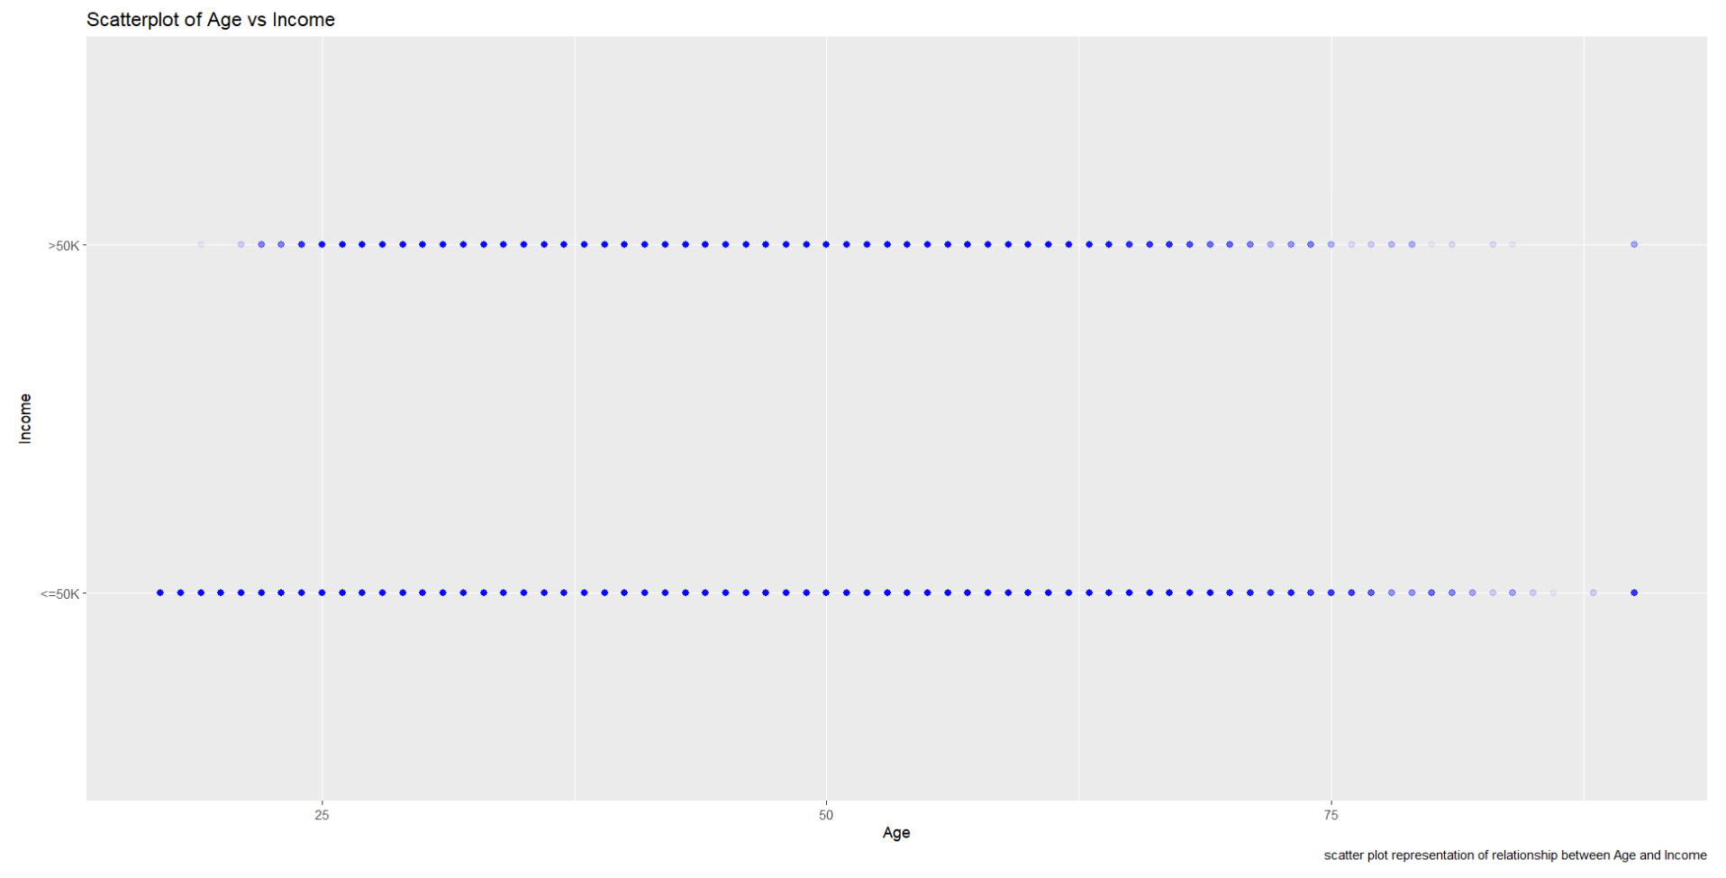
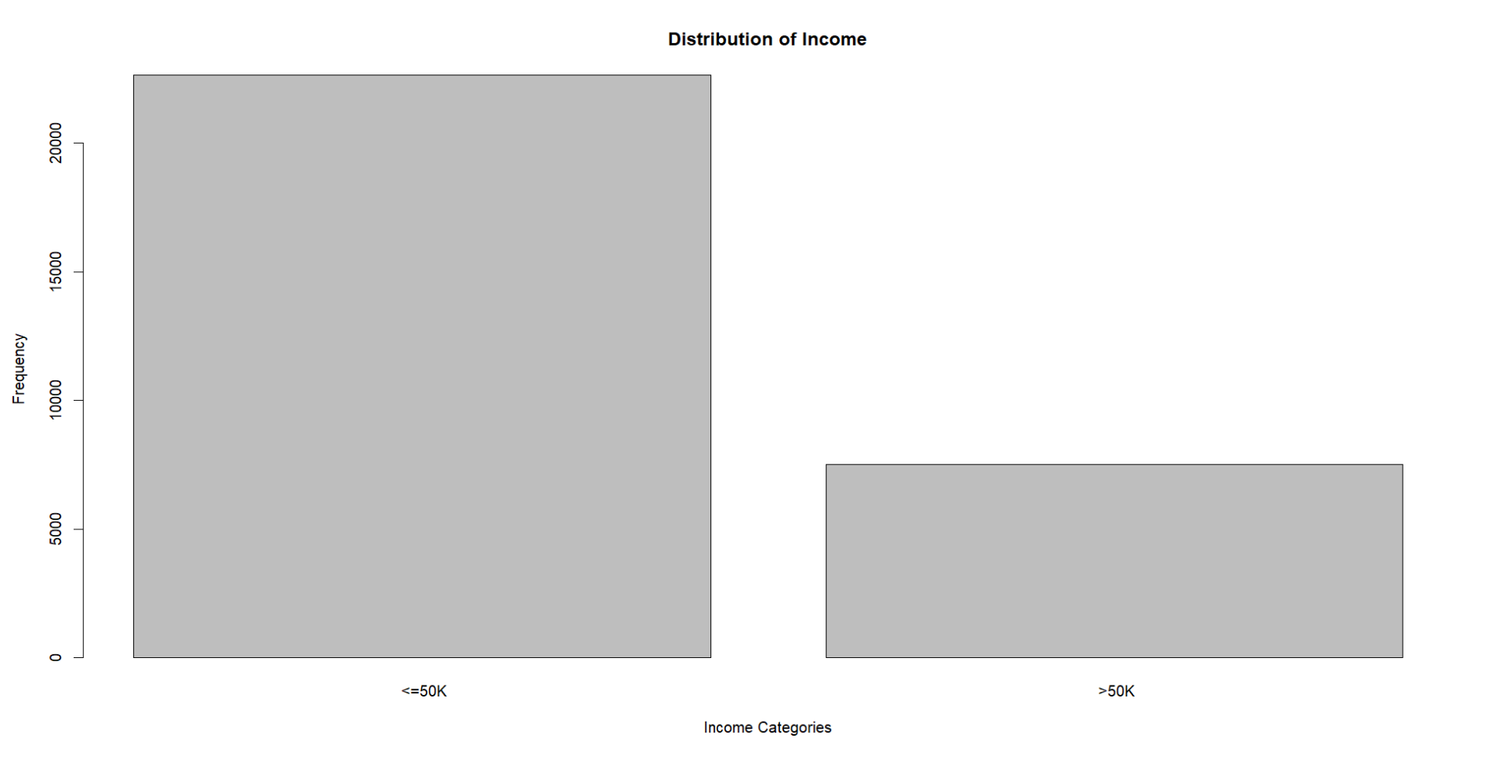
DESCRIPTIVE STATISTICS:
Used ‘summary’ command – to identify the key descriptive stats about the variables in the dataset.
Plotted ‘Scatter Plot’ between one of the input variables – Age and Target variable – Income – to determine the relationship between those.
Used ‘Barplot’ to depict the target variable distribution and frequency.
SCATTERPLOT
BARPLOT

Slide 5
DATA TRANSFORMATION:
One-Hot-Encoding – converted categorical columns into dummy variables using ‘dummyVars()’.
Converted columns – Input Variables - Work class, Education, Marital Status, Occupation, Relationship, Race, Gender, Native Country and Target Variable – Income.
Normalization – Used ‘preProcess’ to normalize the columns in the dataset. Method used to Normalize – Min-Max.

Slide 6
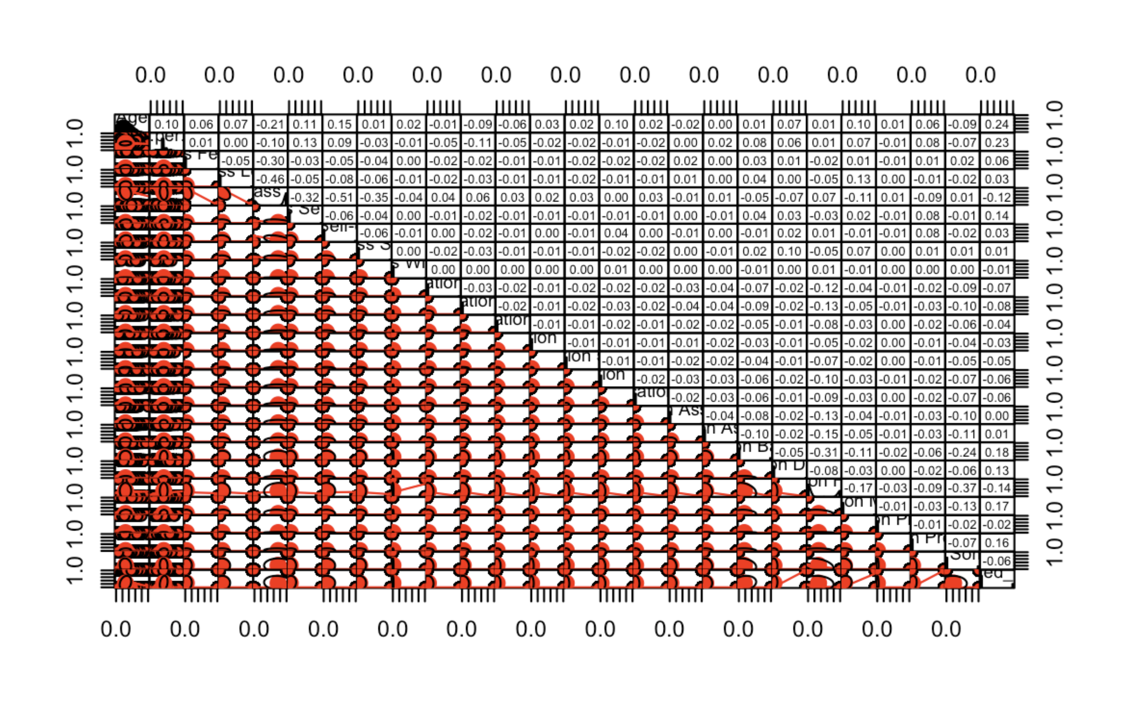
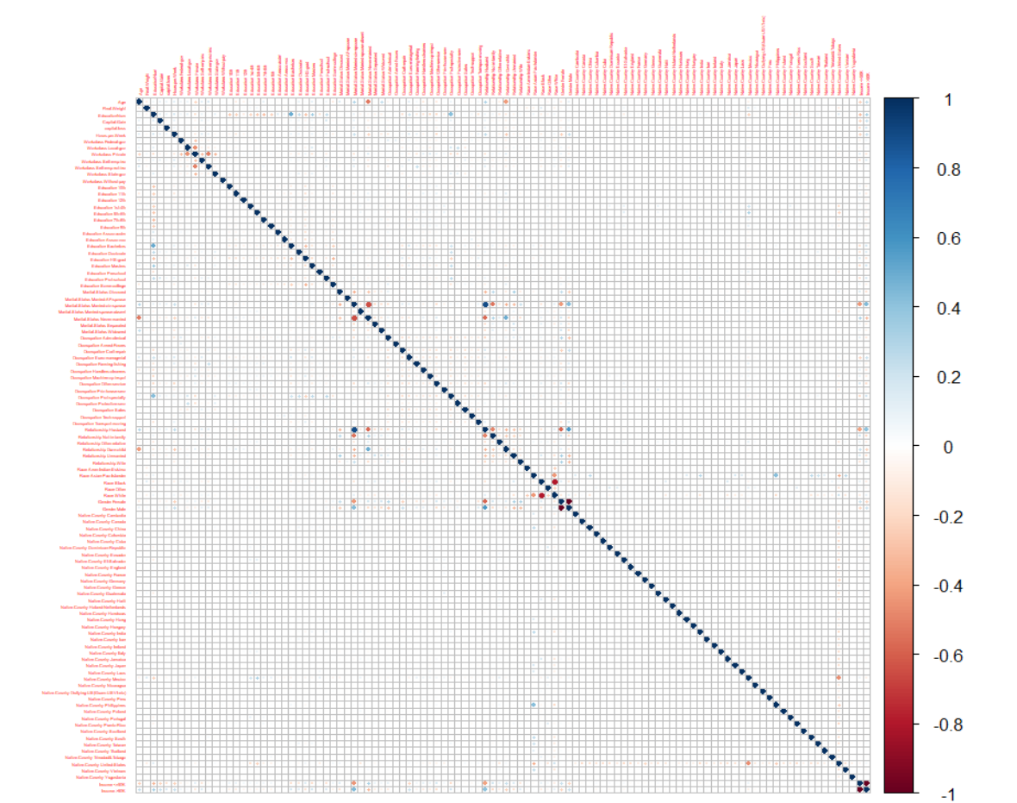
FEATURE SELECTION:
Corrplot: Found the correlation between variables.
Used ‘Corrplot()’ to depict the correlation in the form of a corrplot.
Used ‘Stepwise Regression’ and ‘Backward’ method to perform variable selection.
Results: The above two methods suggested variables – Age, Hours per Week, Work class, and Education could be chosen for our analysis of determining the Income.
CORRPLOT
PAIR MATRIX

Slide 7
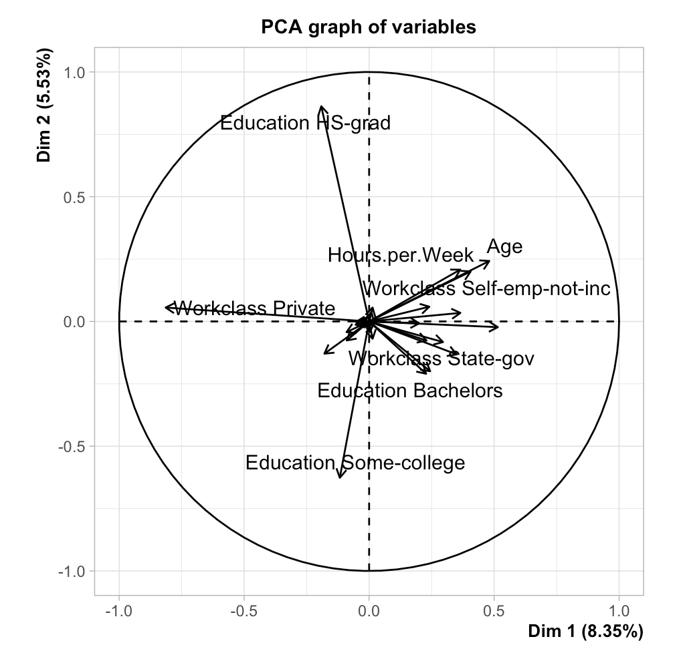
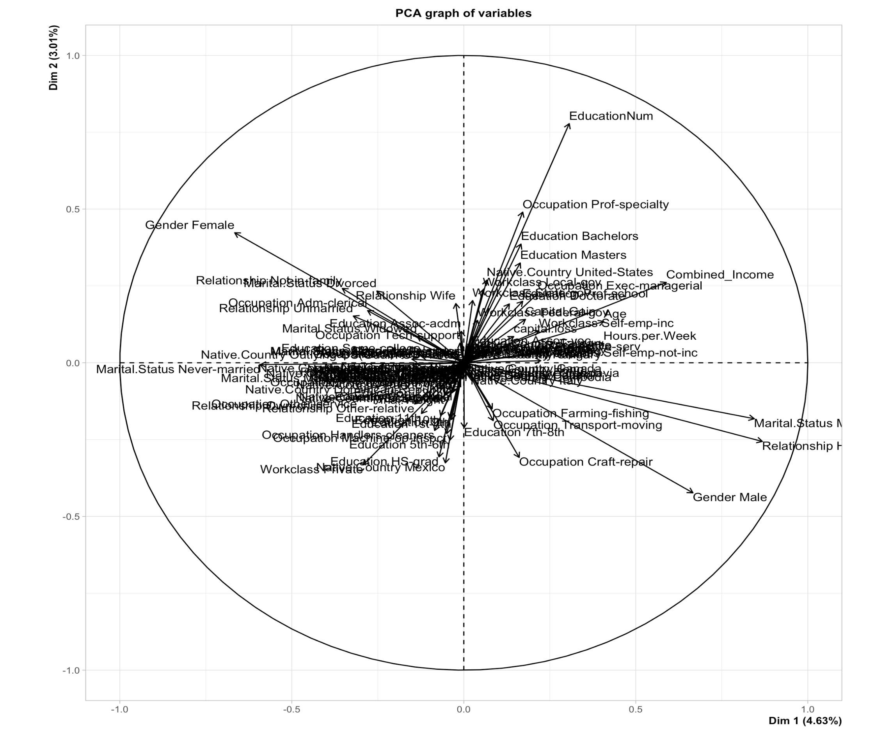
PCA SELECTION COUNT.
PCA FOR ALL VARIABLES
PCA FOR SELECTED VARIABLES

Slide 8
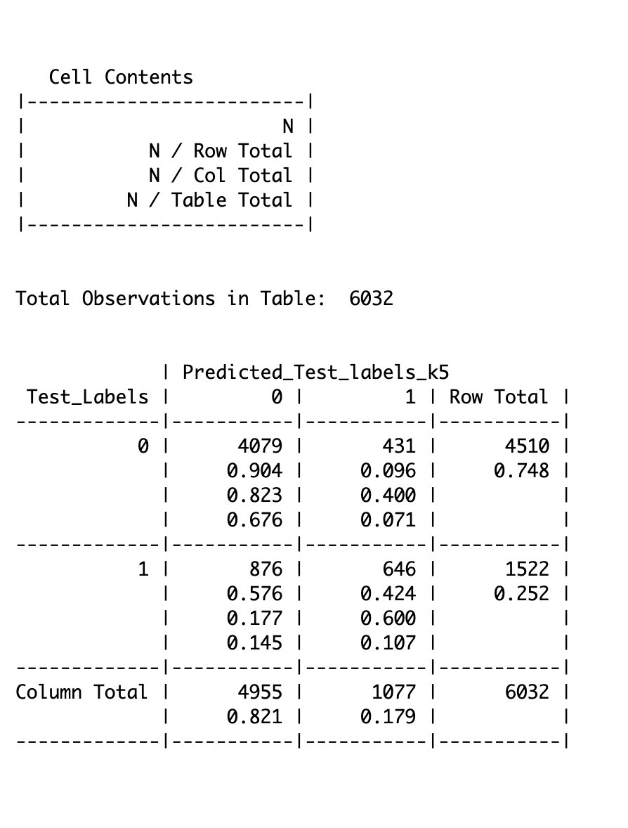
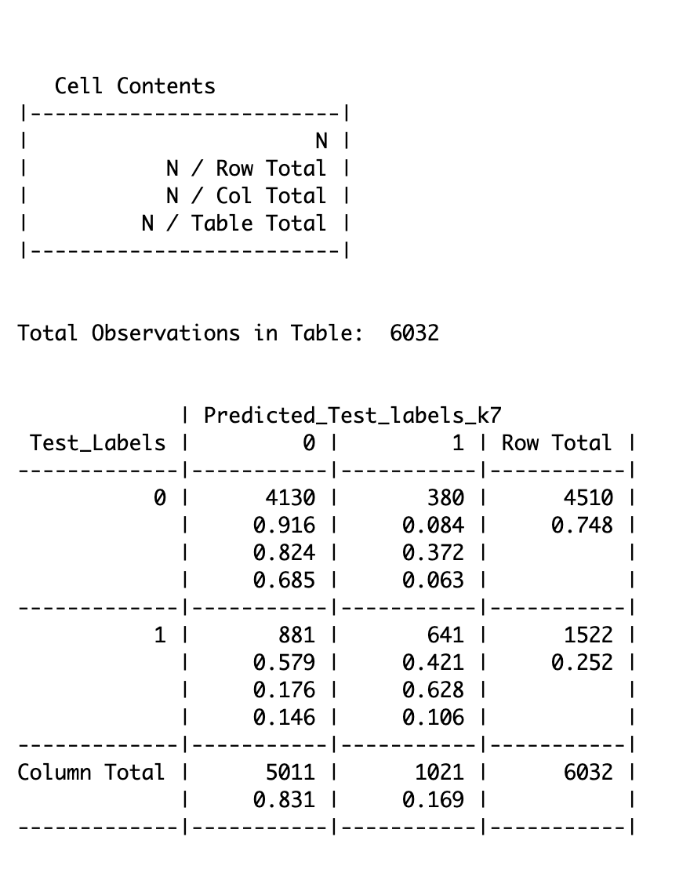

K-NN CLASSIFICATION:
Hyperparameter Tuning : Tuned model. Result showed optimum ‘k’ value is 9.
Data Split : Train[80%], Test sets[20%].
K-NN : Performed K-NN using different ‘k’ values[5,7,9].
Confusion Matrix : Used Confusion Matrix to compare results.
K = 5
K = 7
K = 9

Slide 9
K-NN CLASSIFICATION CONT.
K = 5
K = 7
K = 9
Accuracy – 78.38 %
Recall – 42.42 %
Precision – 60.02 %
Specificity – 90.44 %
Accuracy – 79.07 %
Recall – 42.11 %
Precision – 62.77 %
Specificity – 91.59 %
Accuracy – 79.14 %
Recall – 41.40 %
Precision – 63.31 %
Specificity – 91.91 %

Slide 10
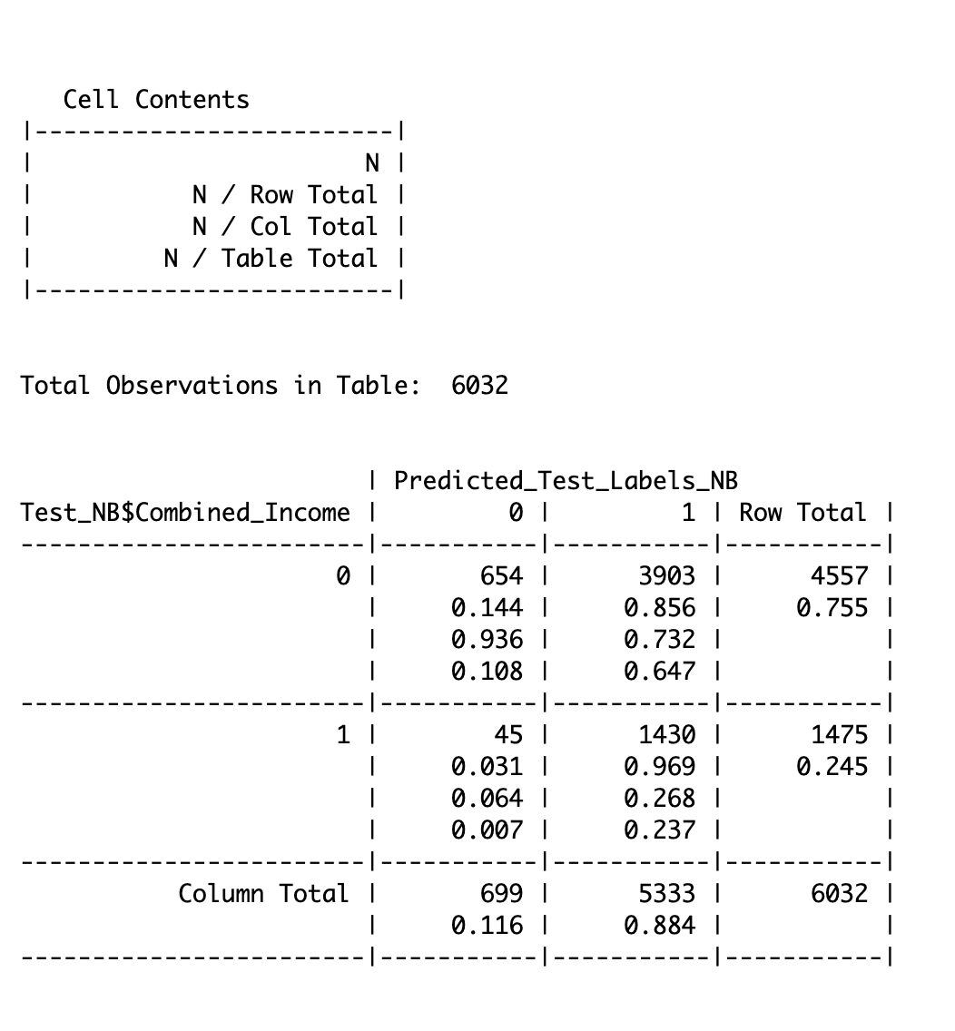
NAÏVE BAYES:
Data Split : Train[80%], Test sets[20%].
Model : Performed Naïve Bayes using ‘naiveBayes’ function.
Confusion Matrix : Used Confusion Matrix to display the results.
Accuracy – 34.50%
Recall – 96.90 %
Precision – 26.80 %
Specificity – 14.30 %

Slide 11
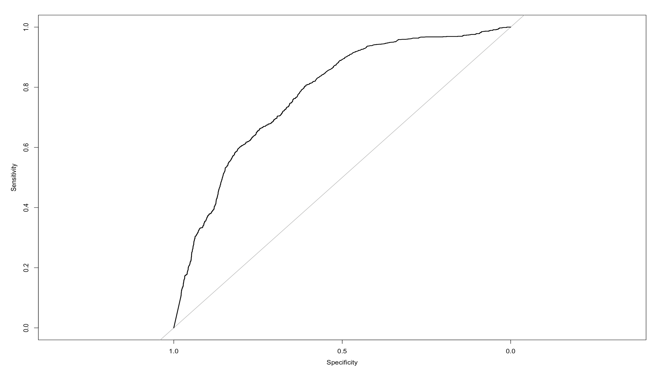
ROC:
INTERPRETATION:
- Closer the curve to the top left corner, the better the performance of the algorithm.

Slide 12
K-NN vs Naïve Bayes:
K-NN [Best ‘k’ value]
Naïve Bayes
Accuracy – 79.14 %
Recall – 41.40 %
Precision – 63.31 %
Specificity – 91.91 %
Accuracy – 34.50%
Recall – 96.90 %
Precision – 26.80 %
Specificity – 14.30 %
INTERPRETATION: K-NN is better suited than Naïve Bayes for this particular classification problem.

Slide 13
BUSINESS USE CASES:
Financial Services
Marketing and Advertising
Government and Policy Making

